Slide 1
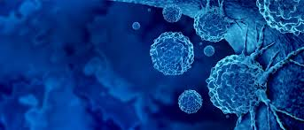




FRACTAL ANALYSIS USING DIFFERENTIAL BOX COUNTING
Under the guidance of Prof. Prabhat Munshi

Slide 2
WHAT IS A FRACTAL?
Infinite patterns
Self similar across different scales
Made by repeating a simple process again and again
Have fractional dimension between 2 and 3.
Let’s create some fractals of our own!

Slide 3
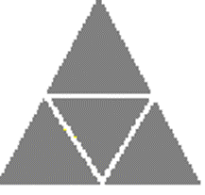
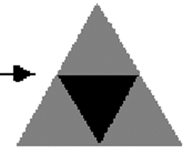
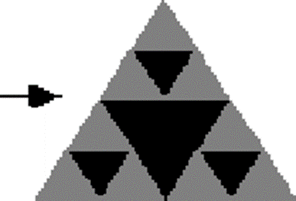
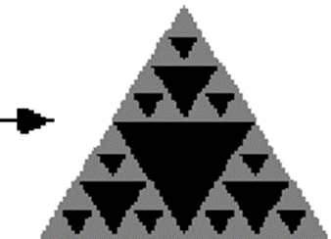
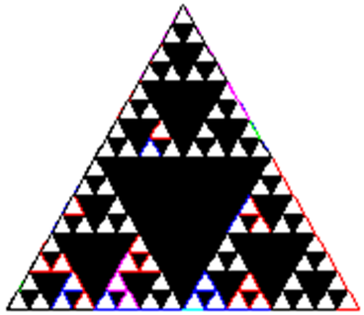
WHAT IS A FRACTAL?

Slide 4
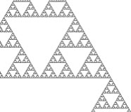
THE SIERPINSKI TRIANGLE

Slide 5
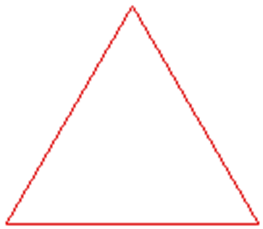
KOCH SNOWFLAKE
Let’s try to build another fractal, called the Koch Snowflake.
Step One: Start with a large equilateral triangle.

Slide 6
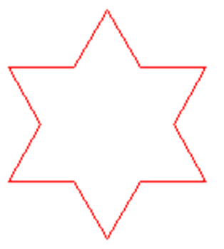
KOCH SNOWFLAKE
Step Two: Make a Star.
Divide one side of the triangle into three equal parts and remove the middle section.
Replace it with two lines the same length as the section you removed.
Do this to all three sides of the triangle.

Slide 7
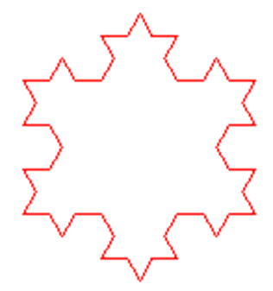
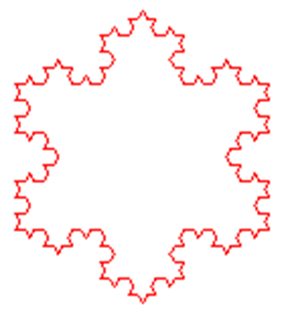
KOCH SNOWFLAKE
Step 3: Repeat the pattern for each outside edge of your snowflake.
Repeat!!

Slide 8
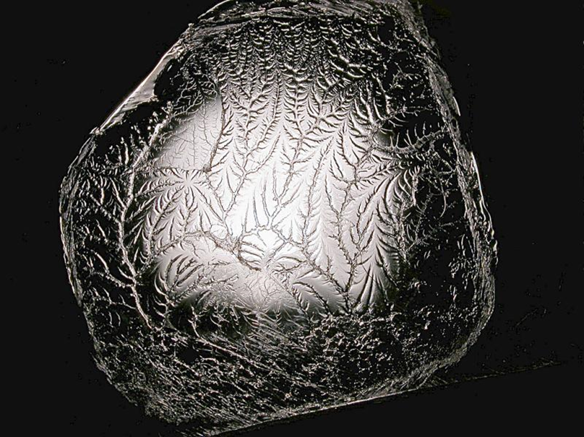
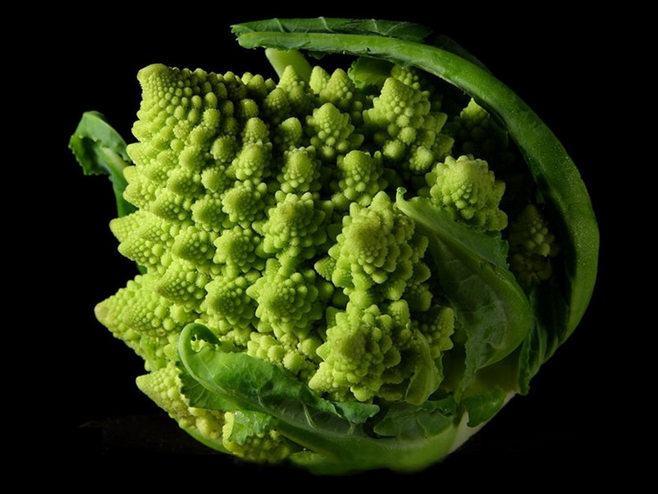
WHERE CAN FRACTALS BE FOUND?
Pulling apart two glue covered sheets forms a fractal!
Fractals can even be found in broccoli!

Slide 9
FRACTAL DIMENSION
It is a quantity which measures the complexity detail in a figure.
It is a fractional number.
More FD means more complex figure.
Similar FD means similar images.
Images can be segmented and saved based on fractal dimension thus reducing storage complexity
It applies to fluid flow images also
Many ways to estimate , we used Box Counting.

Slide 10
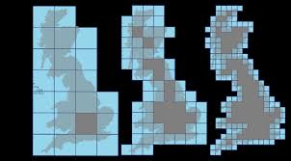
BOX COUNTING ALGORITHM
Minkowski–Bouligand dimension

Slide 11
APPLICATION OF FRACTALS IN CANCER DETECTION
Behavior of cancerous cells is seemingly random and unpredictable. It is little understood and therefore, at present inadequately treated.
It has been observed that cancer cells follow the fractal geometry.

Slide 12
APPLICATION OF FRACTALS IN CANCER DETECTION
We noted that the same algorithm has also been used to quantify 2d cross-sectional images of a three-phase pipe flow system for oil industry applications .
So we manipulated the algorithm according to our requirements to make its use in Cancer Detection.

Slide 13
APPLICATION OF FRACTALS IN CANCER DETECTION
We aim at taking advantage of fractal behaviour of cancerous cells .
Utilize CT/PET/MRI scan image reports. Convert these reports into numerical matrices.
Implement a Python algorithm based on BB Chaudhari's paper to calculate the Fractal Dimension (FD) of the images.
Recognize that the difference in FD between normal cells and cancerous cells is typically greater than 3%.

Slide 14
WE IMPLEMENTED THIS ALGORITHM FOR 25 IMAGES WITH KNOWN FRACTAL DIMENSION VALUES.
LET’S HAVE A LOOK AT THE RESULTS!!!

Slide 15
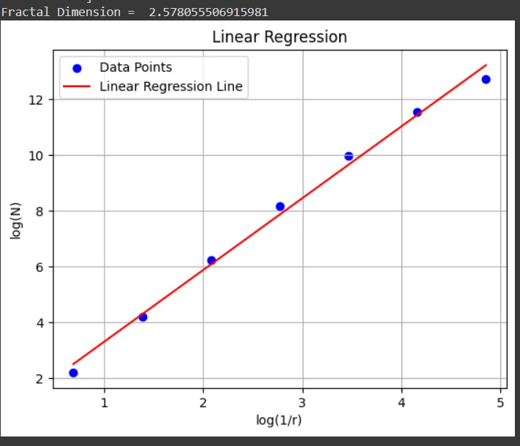
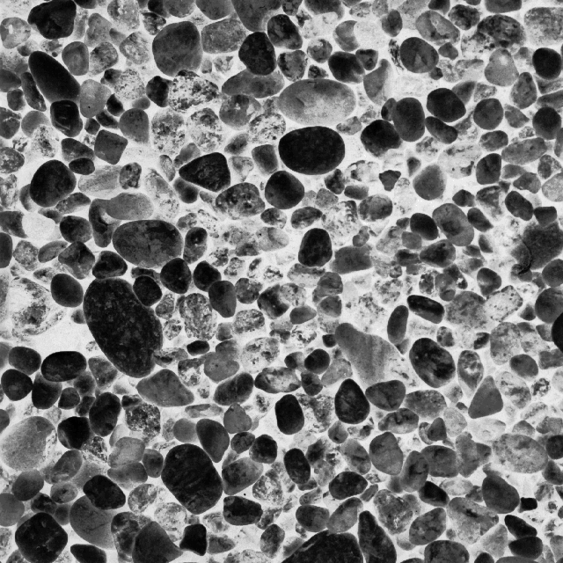
Image D23
Original FD: 2.621
Calculated FD: 2.578
Abs error: 1.6406 %

Slide 16
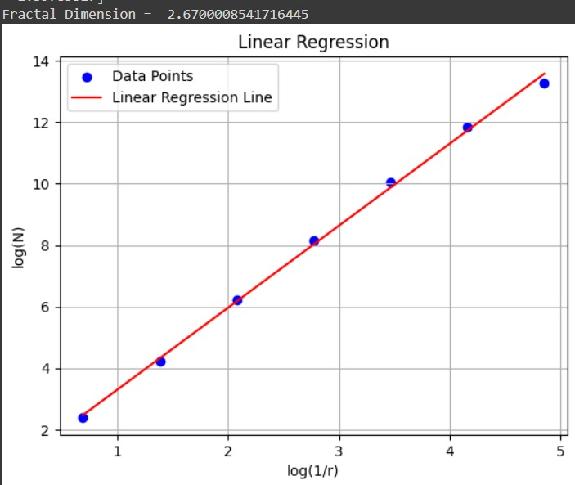
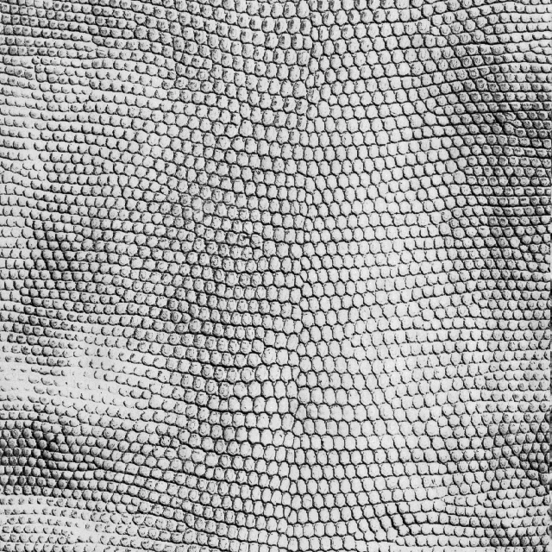
Image D4
Original FD: 2.67
Calculated FD: 2.670001
Abs error: 0.0000375 %

Slide 17
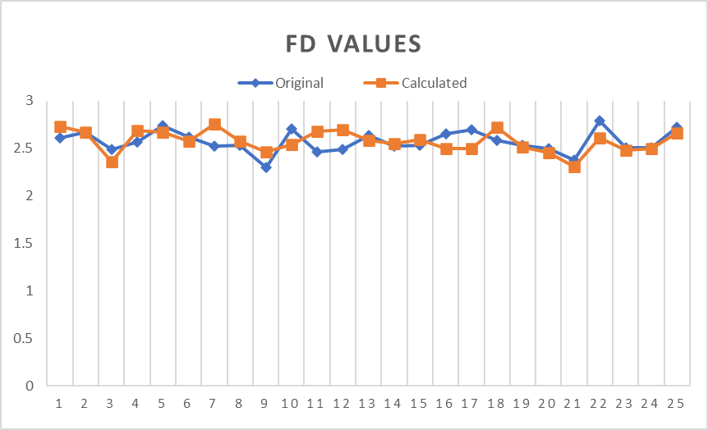
Plot b/w Actual and Calculated FD values of Brodatz Textures
Here is the CSV having our results : CSV

Slide 18
Images can be segmented and saved based on fractal dimension thus reducing storage complexity
It applies to fluid flow images also.

Slide 19
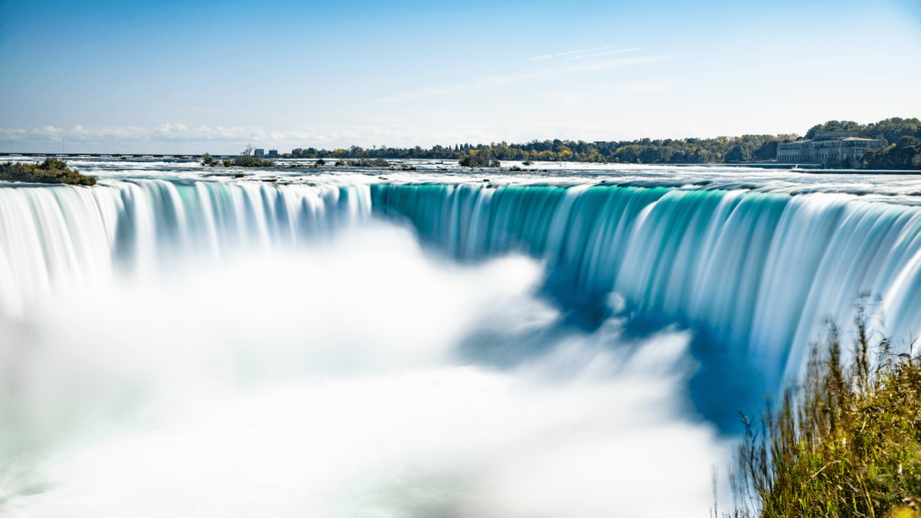
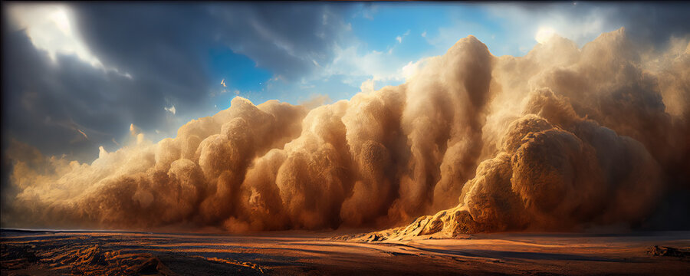
MULTIPHASE FLOW
Simultaneous flow of materials with two or more thermodynamic phases

Slide 20
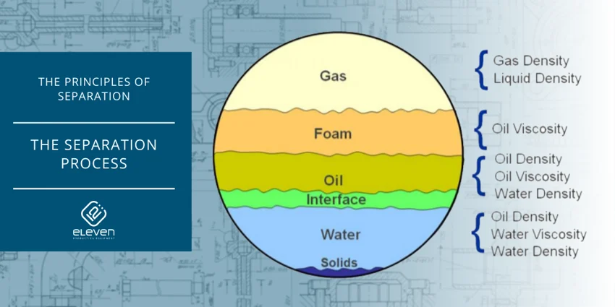
MULTIPHASE FLOW
Concurrent movement of oil, water, gas, and solids within pipelines and production facilities.
Oil: This is the primary substance being pumped. It's the valuable resource extracted from underground reservoirs.
Gas : Natural gas can often be found alongside oil deposits. It's composed primarily of methane but can contain other hydrocarbons as well.
Water : Water is also present in many oil wells, either naturally occurring alongside the oil or injected into the well to maintain pressure or enhance oil recovery.

Slide 21
MULTIPHASE FLOW
Efficiency : Efficient separation of oil, gas, and water is essential for optimizing production and minimizing waste.
Safety : Proper distribution ensures that equipment operates safely and effectively, reducing the risk of accidents or equipment failures.
Environmental Impact: Accurate phase distribution helps minimize environmental impact by preventing spills or leaks of oil or other substances.
X-ray tomography is used to visualize and analyze the distribution of these phases within the flow.

Slide 22
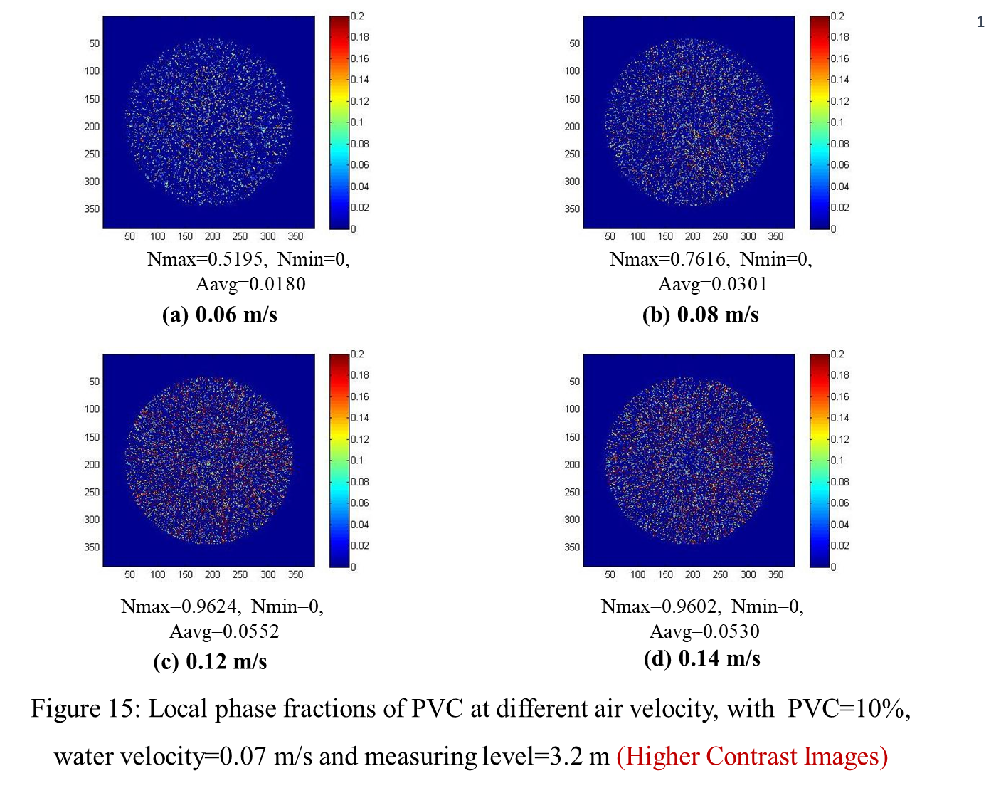

Slide 23
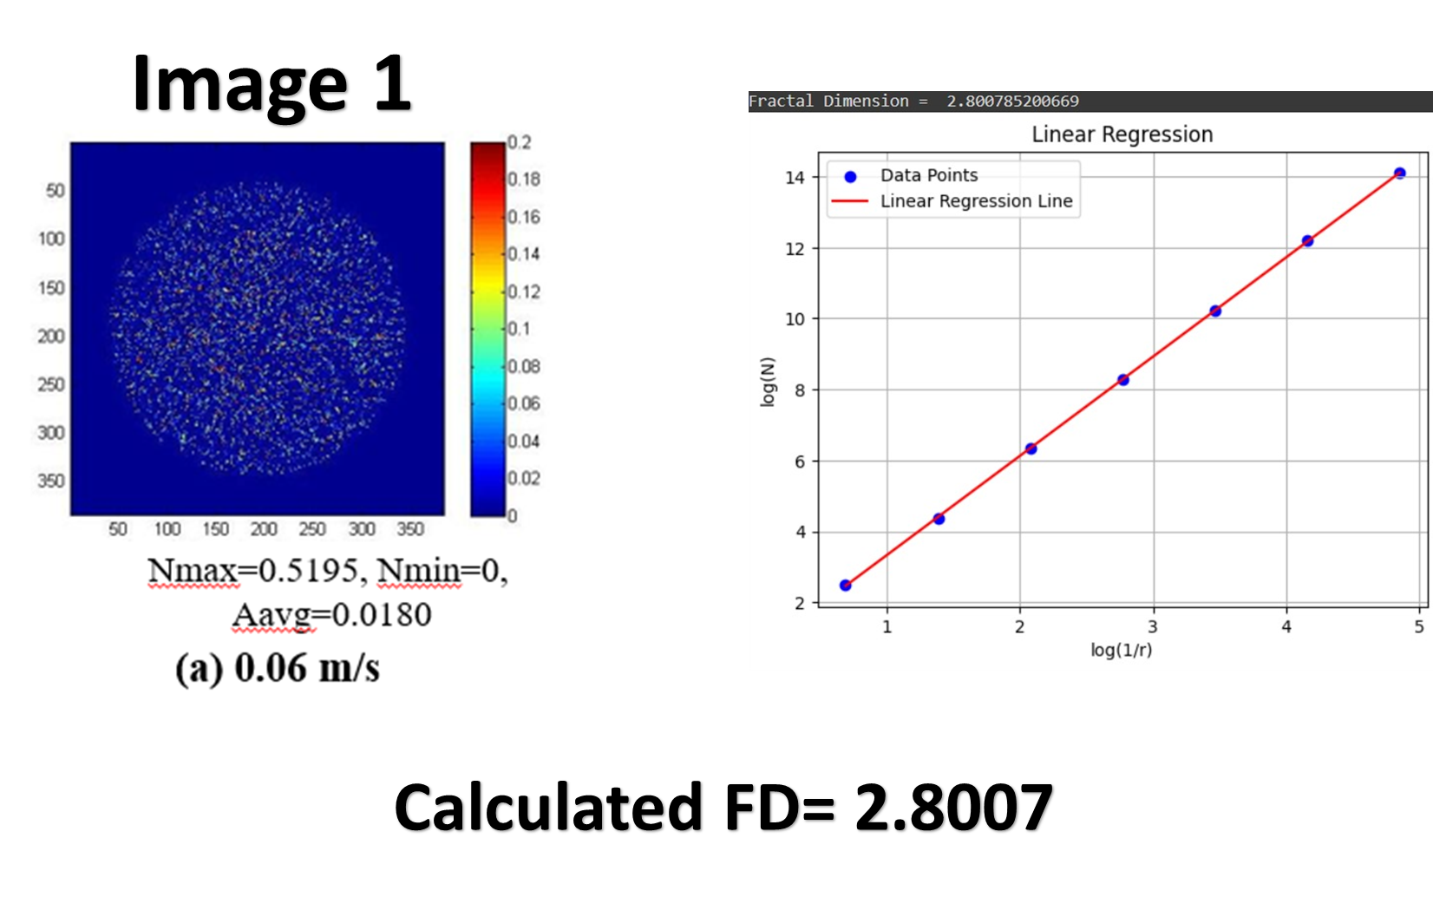

Slide 24
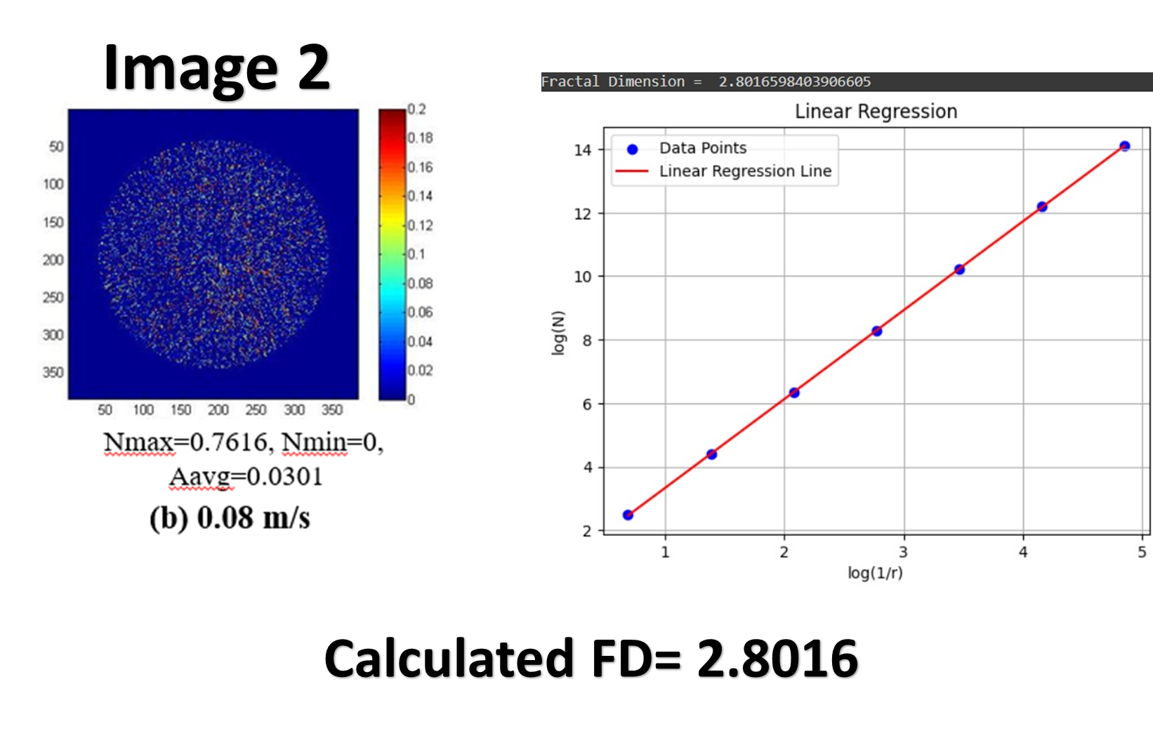

Slide 25
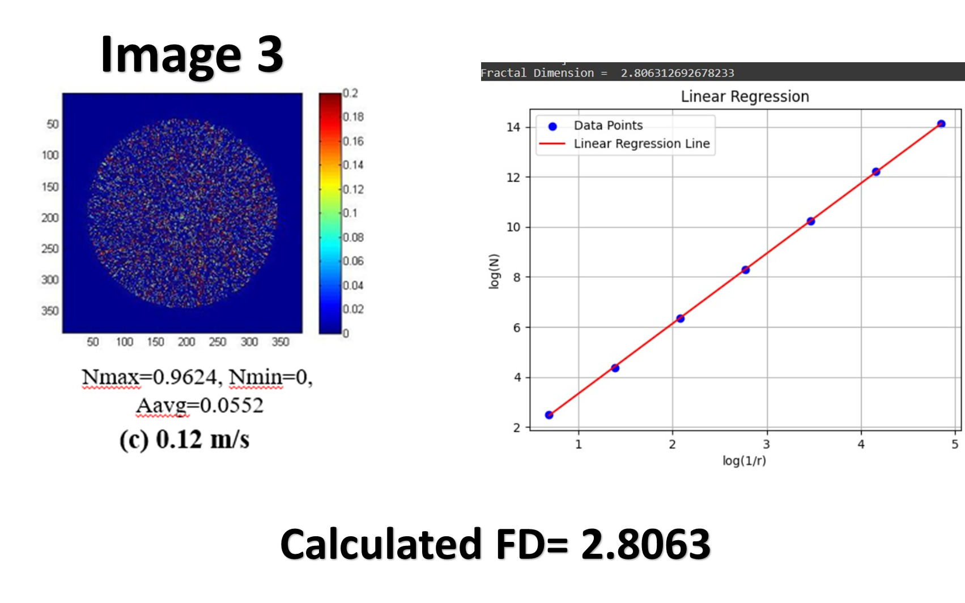

Slide 26
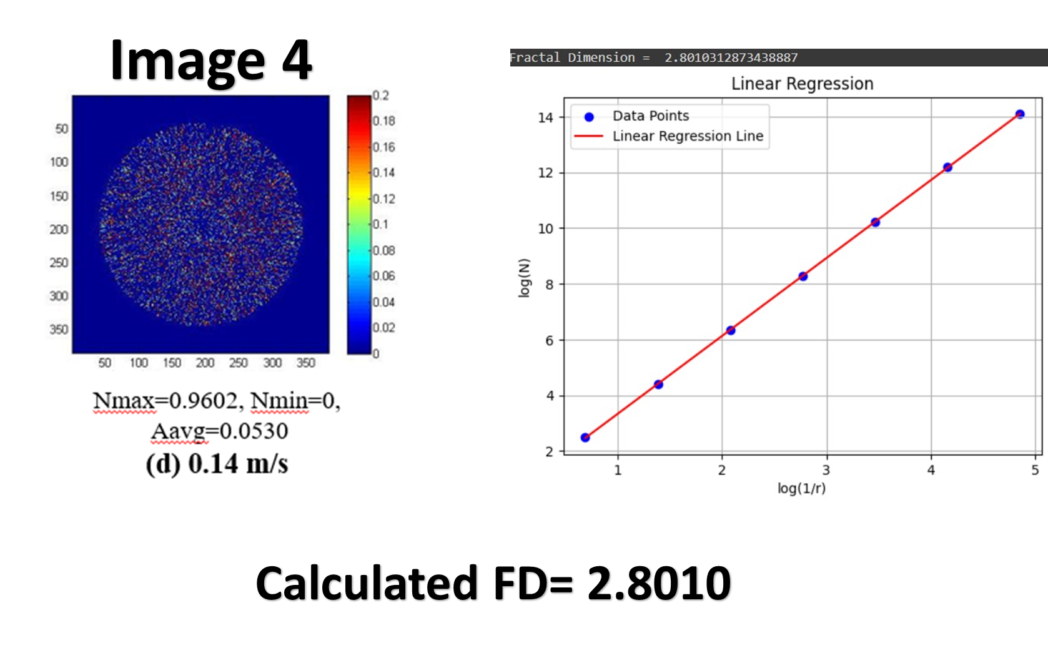

Slide 27
POSSIBLE IMPROVEMENTS
In our calculation we resized all images to 256*256 so some information could be lost ( for larger images ) and some incorrect info could be considered (for smaller images).
Some figures gave error > 10% , we could try changing parameters to possibly reduce this.
Our method works only for 3d images.
And some more..

Slide 28
PROGRESS OF OUR PROJECT
We have devised the algorithm to convert an image into matrix.
We have also implemented the algorithm used in phase flow diagram to calculate fractal dimension
We are able to segregate the images to some extent based on our algorithm but it still needs to be reviewed for precision.
We are yet to train the AI model for concluding our project which we have decided to do in summers.

Slide 29
Refrences:
An_Improved_Method_to_Estimate_the_Fractal_Dimension_of_Color_Images?
https://en.wikipedia.org/wiki/Minkowski%E2%80%93Bouligand_dimension
Fractal_Algo_BoxCounting by Nirupam Sarkar and B. B. Chaudhuri.
https://www.mdpi.com/1099-4300/19/10/534
https://multibandtexture.recherche.usherbrooke.ca/normalized_brodatz.html
https://www.researchgate.net/figure/Computational-fractal-dimensions-of-Brodatz-texture-images_tbl1_224057945
https://www.intechopen.com/chapters/6684BB Chaudhari and Nirupam Sarkar.
Special thanks to Prof. Prabhat Munshi , Pridhi Athe , nehlata Shakhya.

Slide 30
THANK YOU !!!

